Slide 1

Faculty Senate Meeting - November 18, 2022
Budget Presentation SUNY Old Westbury
Report for the
FY 2022-2023
Prepared by
Business & Finance

Slide 2

Matters on the Docket
A brief look at what we will discuss on this presentation
01
Budget Terms
02
Typical Annual Budget Cycle
03
Revenue Sources
04
Cash Reserves
05
FY 22-23 Budgets, Allocations and FTEs
Continued…

Slide 3
Matters on the Docket
A brief look at what we will discuss on this presentation
06
Budgets FYs 21-22 vs. 22-23
07
Factors Affecting Financial Situation
08
Student Enrollment
09
Spending Constraints
10
Budget Office Contacts

Slide 4

01
Personal Services Regular. This category represents all salaried employees of OW.
Budget Terms
PSR
Other Than Personnel Services.
This category includes supplies, utilities, travel, contracts, software, equipment, etc.
OTPS
Temporary Services. This category represents all temporary personnel of OW, including adjuncts, certain consultants, etc.
TS
This category includes payments to SUNY for SUNY-provided services to OW, such as servers, programming, etc.
Recharges
Dormitory Income Fund Reimbursable. Revenue from the operations of student residence halls.
DIFR
Income Fund Reimbursable. Revenue from student fees (e.g., technology, transportation, health, athletics) and other revenue.
IFR

Slide 5
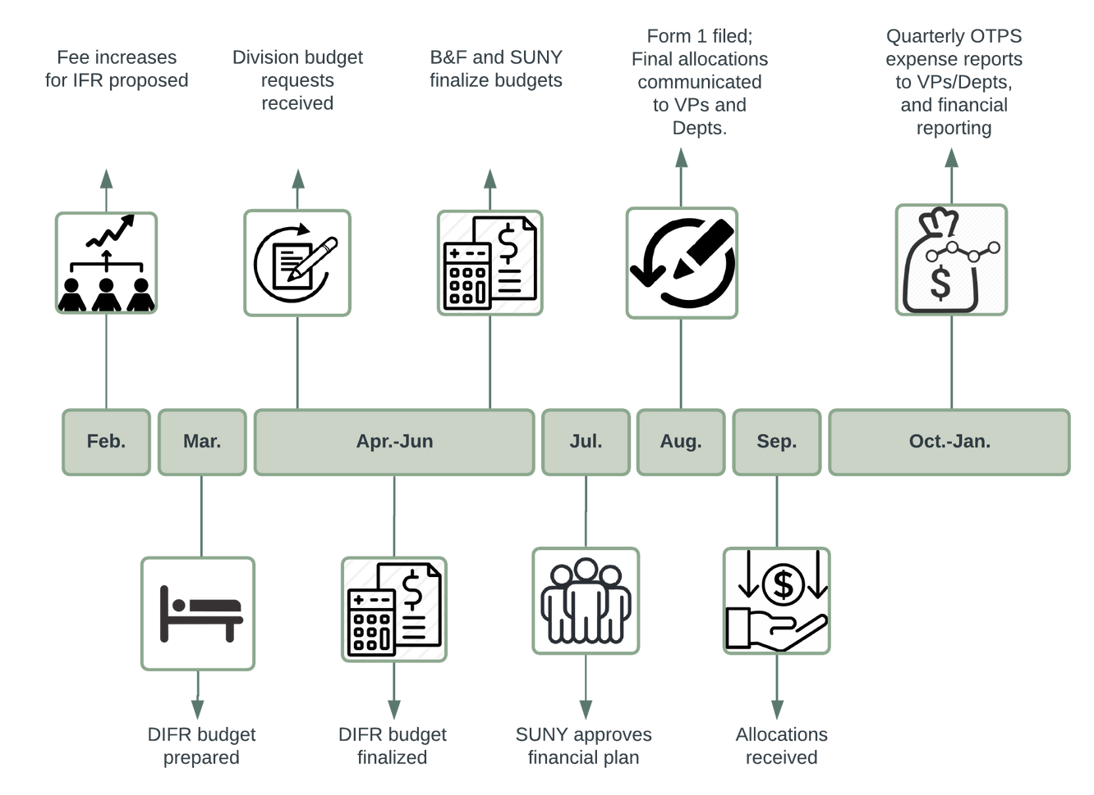
02
Typical Annual Budget Cycle*
*Dependent on SUNY

Slide 6






03
FY 2022-2023 Revenue Sources
Reserves* 8.56%
STUDENT TUITION
STATE SUPPORT
Fees & Rentals
11.41%
Student Tuition
53.18%
FY 22-23 REVENUE
RESIDENCE HALLS
Sources
FEES & RENTALS
Residence Halls
7.6%
RESERVES
State Support
19.23%
* Includes 21-22 HEERF III

Slide 7
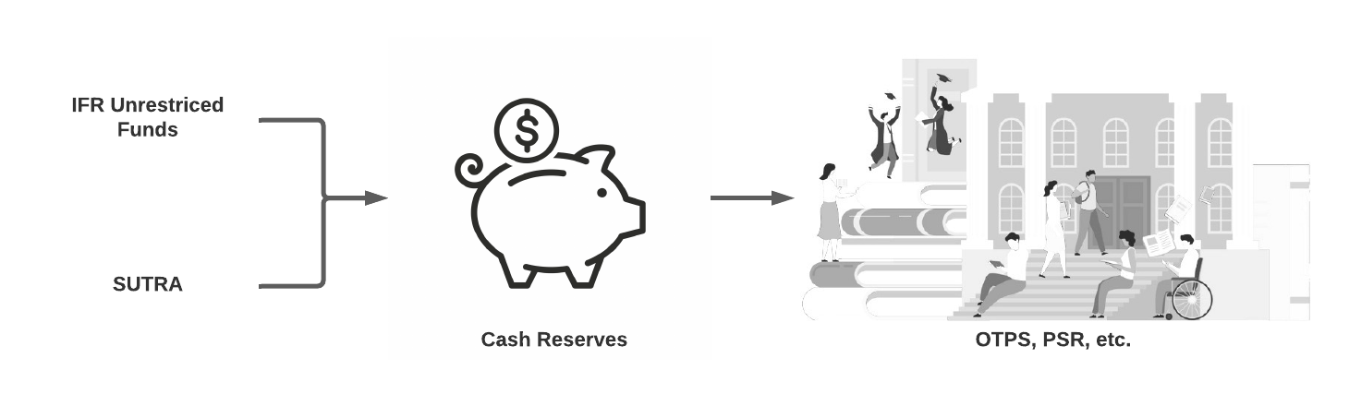
04
Current cash reserves are approximately $16M. The College plans on a cash reserve of 15% to 18% of State and IFR expenses each year.
Cash Reserves

Slide 8
05
Recharges
1.5%
TS
7.2%
OTPS
21.2%
PSR
70.1%
$52,385,670
FY 2022-2023 Financial Plan

Slide 9
05
Academic Affairs - 54.8%
Facilities - 10.5%
Fixed Costs - 9.3%
Student Affairs – 9.1%
ITS - 7.7%
B&F – 5.9%
UPD - 5.1%
Enrollment - 2.8%
Communications - 2.0%
President - 1.9%
Advancement - 1.2%
HR - 1.1%
DEI - 0.2%
0%
20%
40%
60%
All Funds Budget- Allocations by Division

Slide 10
05
As of October 1, 2022
Total FTE All Funds = 497.60
Excludes vacancies
All Funds - FTE by Division
FY 2022-2023

Slide 11
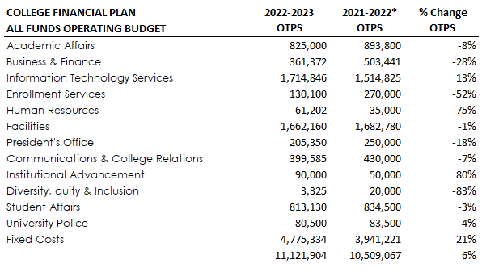
06
Prior Year Change - OTPS
*2021-2022 OTPS denotes total allocation.

Slide 12


07
Factors Affecting our Financial Position
FY 2022-2023
$1.2 million
$2.7 million
$2.5 million
Lower tuition revenue
Lower fees & rentals revenue
Higher expenses
A marked decrease in enrollment, (18%) in total, since 2019 has resulted in revenue losses. Revenue losses were $2.0M for FY 2021-2022 and are projected to be $1.2M for FY 2022-2023, for a total of $3.2M for the last two years.
Residence hall lower density ($2.0M). Lower student fees and facilities rentals ($660K).
Contractual obligations, including salaries, have increased in the last 4 years. Higher expenses due to inflation, particularly utility costs. Our utilities cost has increased $1M this FY.

Slide 13
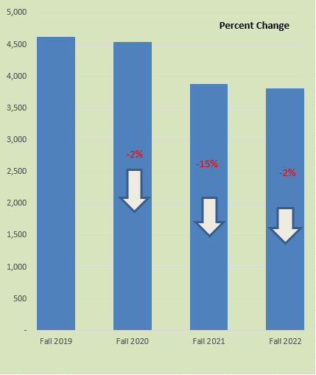

08
Student
Enrollment
FY 2019-2020 to FY 2022-2023
Student Enrollment Fall 2019 Fall 2020 Fall 2021 Fall 2022
Actual FTE 4,628 -3% 4,544 -10% 3,880 -3% 3,810
Student enrollment has significantly decreased since FY 2019-2020
Enrollment has decreased 17.7% from FY 2019-2020 to FY 2022-2023.
Data provided by Institutional Effectiveness

Slide 14

09
Spending Constraints
Hiring Slowdown
Hires are prioritized based on health and safety, essential instruction and research in areas of high-need and high enrollment, critical student facing needs and revenue generation.
Reduced Expenses
Restrictions on overtime, with some exceptions. Elimination or deferment of non-essential extra service and course releases.
Reduction in energy consumption and costs.
Reduced Discretionary Expending
All discretionary spending should be evaluated, if not mission critical. This includes memberships, travel, food/meals, events, and other expenditures that are not critical to the operation of the College.

Slide 15

Questions
CFO
Martha Santana
Contact us anytime!
Budget Office
Pat Lettini
Jennifer Jimenez
Rick Fan

